Slide 1

Chapter 19
How JavaScript and jQuery are used to enhance your web pages
Notes:
Session: Ghi số thứ tự session trong môn học
Session Name: ghi tên của session sẽ dạy

Slide 2
Objectives
Introduction to JavaScript and DOM scripting
The Email List Application in JavaScript
Introduction to jQuery
How to use jQuery in Email List application
How to use JavaScript and jQuery as a non-programmer
jQuery UI & jQuery Plugin
Notes:
Mô tả nội dung mà học viên phải đạt được khi kết thúc môn học này

Slide 3
Introduction to JavaScript and DOM scripting

Slide 4
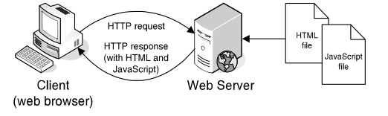
How JavaScript works
JavaScript is a scripting language that is run by the JavaScript engine of a browser. The work is done on the client, not the server
How JavaScript fits into the client/server architecture
Notes:
Mô tả nội dung chi tiết từng chuyên đề

Slide 5
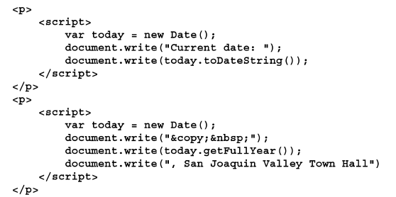
JavaScript example
JavaScript in HTML document

Slide 6
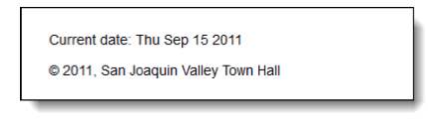
Result in web browser
The JavaScript in a web browser.
Notes:
Mô tả nội dung chi tiết từng chuyên đề

Slide 7
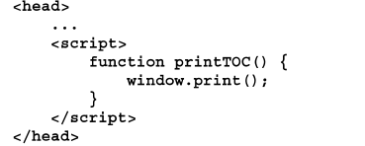
Three ways to include JavaScript in a web page
A script element in the head section that heads an external JavaScript
A script element in HTML
Embeds JavaScript in the body

Slide 8
The DOM (Document Object Model) works
The DOM (Document Object Model) is a hierarchical collection of nodes in the web browser’s memory that represents the current web page.

Slide 9
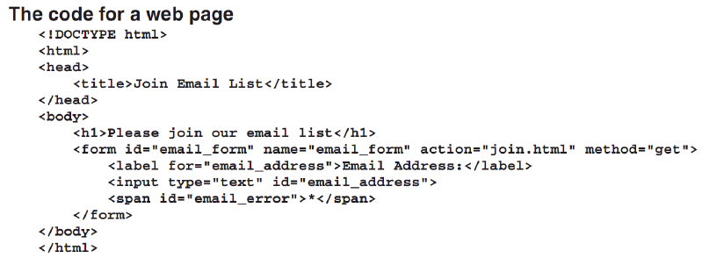
Example: The DOM for a web page

Slide 10
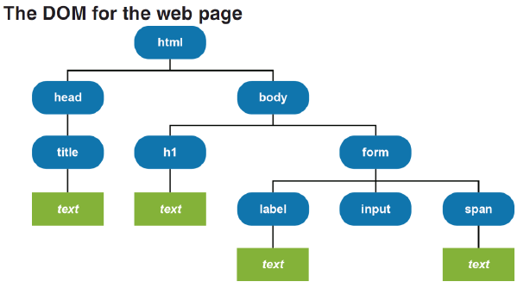
Example: The DOM for a web page

Slide 11
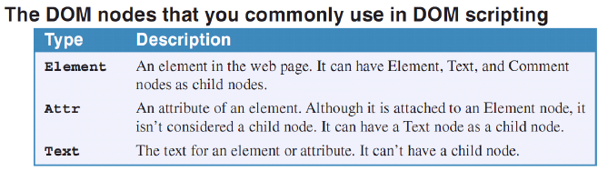
The DOM scripting works

Slide 12
Methods and properties for DOM Scripting
Two methods of the document object
Three properties that can be used for scripting the DOM
Method | Description
getElementById( id ) | Gets the HTML element that has the id that’s passed to it and returns that element.
write( string ) | Writes the string
Property | Description
value | For an input element like a text box, gets or sets the value in the element.
firstChild | Return a Node object for the first child node of an element
nodeValue | For a Text, Comment, or Attribute node, gets or sets the text that’s stored in the node.

Slide 13
How DOM scripting works
DOM scripting is the process of manipulating the DOM by using JavaScript
An event is an action the user performs like clicking a mouse button. When the event occurs, JavaScript is used to process it. This code is called an event handler

Slide 14
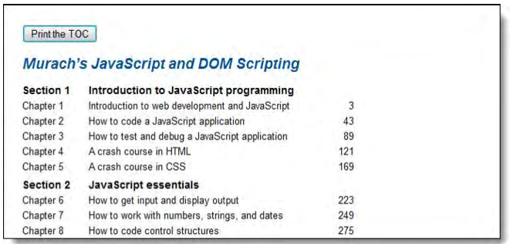
DOM Example
A web page that uses a JavaScript button for printing

Slide 15
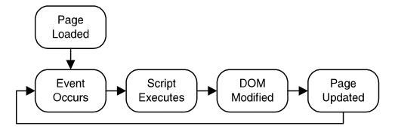
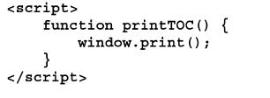
DOM code Example
The DOM event cycle
The JavaScript in the head section
The HTML code
Notes:
Demo:
- How to use (3 ways: embed, function on head and External).
Demo to change HTML element content
Demo to change CSS
Demo to get value at form

Slide 16
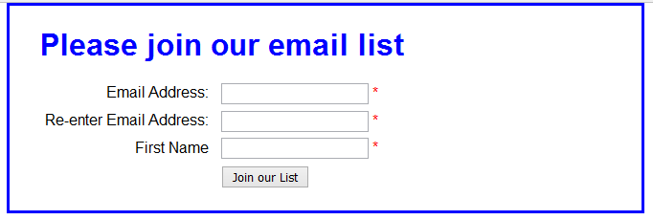
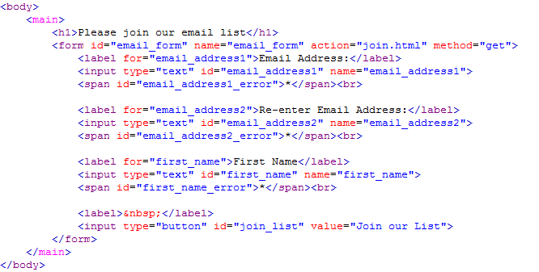
The Email List Application in JavaScripts (page 508)

Slide 17
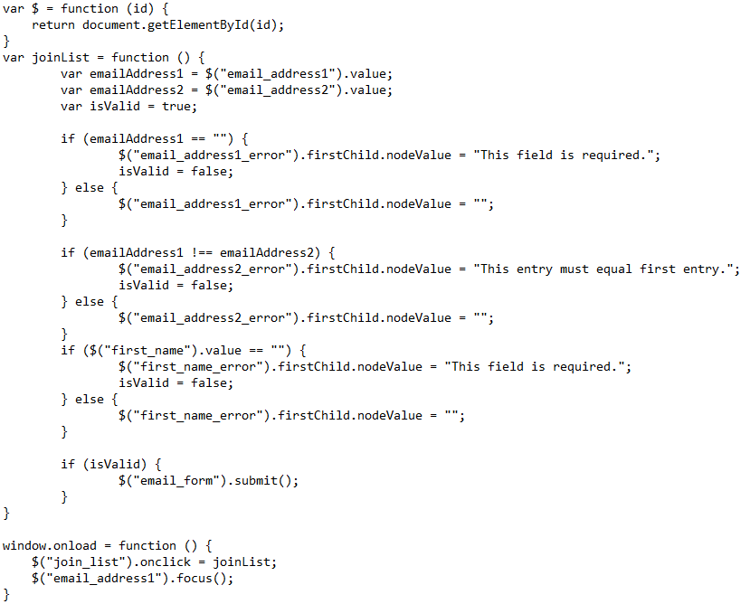
The Email List Application in JavaScripts (page 508)

Slide 18
Introduction to jQuery

Slide 19
What jQuery is and where to get it
jQuery is a free, open-source, JavaScript library that provides dozens of functions for common web features
JavaScript library that makes JavaScript programming easier
It provides widgets, interaction, effects, and themes that can be use to build features like carousels and slide shows
JavaScript library that provides higher-level function like advanced widgets that can be easily customized by using themes that override the themes component of jQuery
Notes:
Mô tả nội dung chi tiết từng chuyên đề

Slide 20
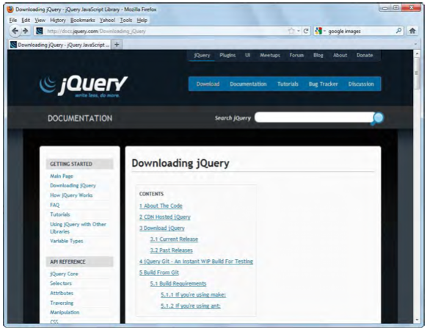
jQuery website
The jQuery web site at www.jQuery.com

Slide 21
jQuery libraries
The two jQuery libraries
jQuery (the core library)
jQuery UI (User Interface)
What jQuery offers
Dozens of functions that make it easier to add JavaScript features to your web pages
Functions that are tested for cross-browser compatibility

Slide 22
How to include jQuery and jQuery UI in your web pages
To use jQuery, you need to include 03 files to jQuery applications
The jQuery JavaScript file
The jQuery UI JavaScript file
The jQuery UI stylesheet
Two ways to include the jQuery files
Include the jQuery files from a Content Delivery Network (CDN) and
Include the jQuery files when they’re on web site
Notes:
Mô tả nội dung chi tiết từng chuyên đề

Slide 23
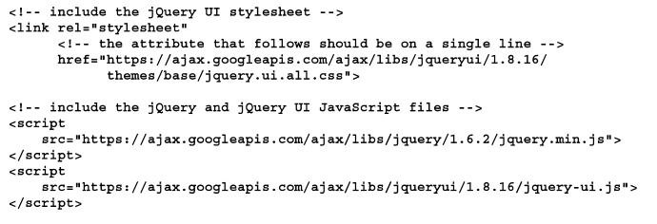
Include the jQuery files from a Content Delivery Network

Slide 24
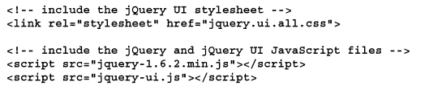
Include the jQuery files when they’re on web site

Slide 25
How to use jQuery
Code jQuery selectors
A type selector that selects all h1 elements
$(“h1”)
An id selector that selects the element with “accordion” as its id
$(“#accordion”)
A class selector that selects all elements in the “fadein” class
$(“.fadein”)

Slide 26
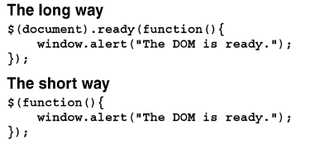
How to use jQuery
How to call jQuery methods
A call to the hide method of an h1 object
$(“h1”).hide(“slow”)
A call to the accordion method of the element with “accordion” as its id
$(#accordion).accordion()
Two ways to code a function that uses the jQuery ready method

Slide 27
How to use jQuery
How to call jQuery event methods
How to code ready event method
$(document).ready(function() {
alert(“The DOM is ready”);
});
How to use the click event method within the ready event method
$(document).ready(function() {
$(“h2”).click(fuction(){
alert(“This heading has been cliked”);
});
});

Slide 28
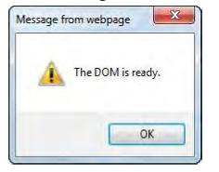
Result in web browser
The message box that’s displayed when the DOM is ready

Slide 29
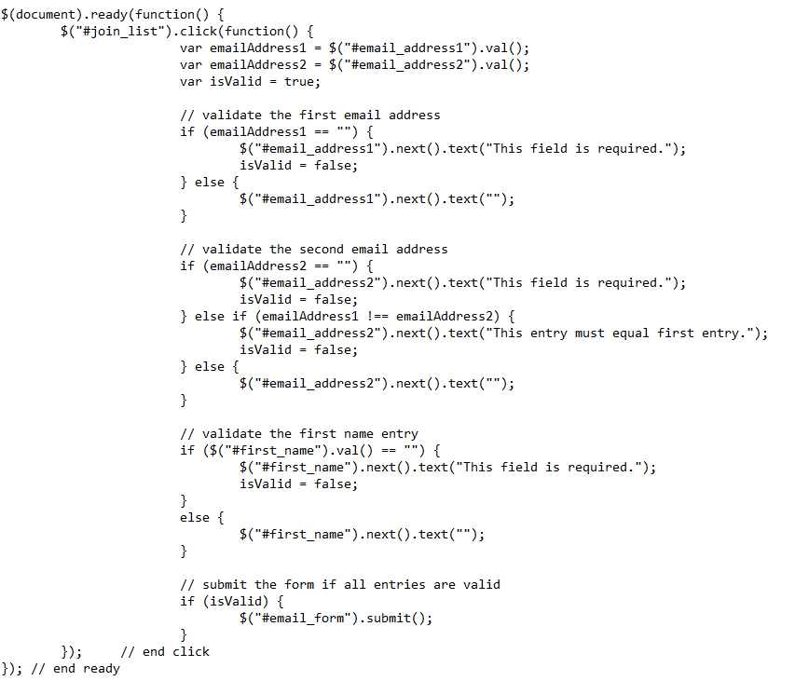
The Email List Application in jQuery (page 516)

Slide 30
How to use jQuery as non-programmer

Slide 31
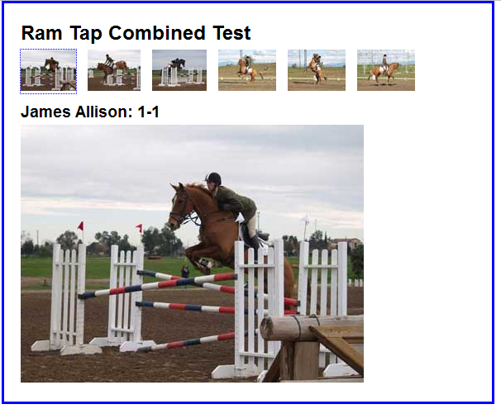
Image swap application
An image swap occurs when an event handler uses DOM scripting to replace one image with another.
A web page after the second thumbnail has been click

Slide 32
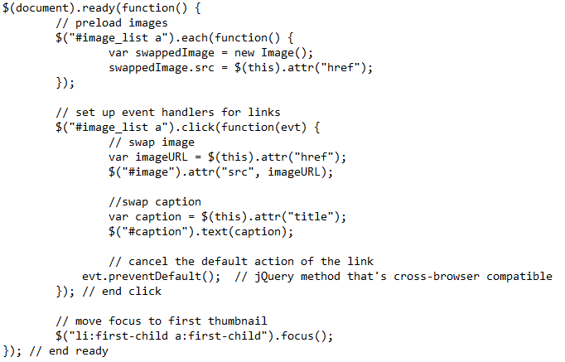
Image swap application – jQuery code

Slide 33
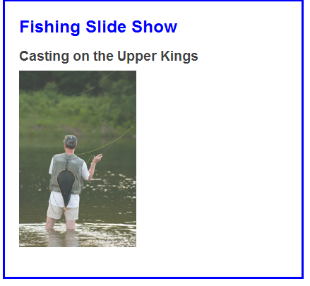
A slide shows application
Use jQuery to create a slide show. When the page loads, the first image is displayed. Then, every five seconds, the image fades out and the next image fades into its place.
A slide show that fades one image out and the next image in

Slide 34
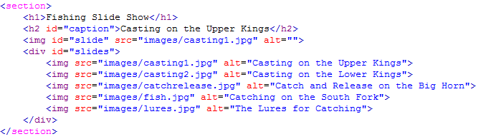
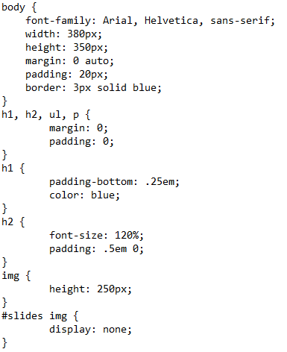
A slide shows application - code
The HTML for the slide show
The CSS code

Slide 35
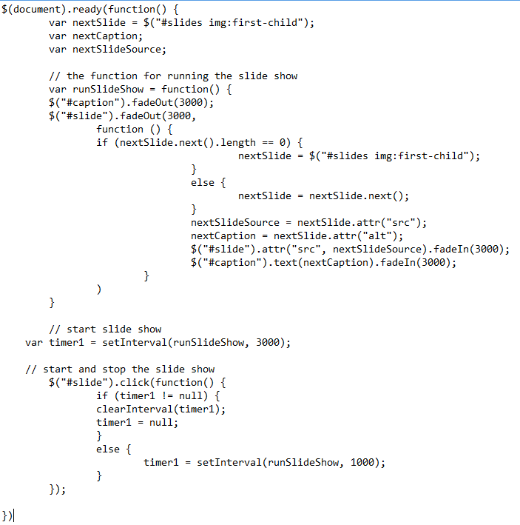
A slide shows application - code
jQuery code

Slide 36
jQueryUI & jQuery plugin

Slide 37
Introduction to jQuery UI
jQuery UI is a free, open-source, JavaScript library that extends the use of the jquery library.
jQuery UI provide higher level features that you can use with a minimum of code.
jQuery UI uses jQuery and can be thought of as the official plugin library for jQuery.
Get the jQuery UI from http://jqueryui.com

Slide 38
The four types of features provides by jQuery UI
Name | Description
Widgets Themes Interactions Effects | Accordions, tabs, date pickers, and more. 24 predefined themes as well as a ThemeRoller application. Draggable, droppable, resizable, and more. Color animations, class transitions and more

Slide 39
Include jQuery UI to your application
CSS file
<link rel = “stylesheet” href=“…./jquery-ui.css”>
JavaScripts
<script src=“…./jquery-2.1.3.min.js”> </script>
<script src=“…./jquery-ui.js”> </script>

Slide 40
How to use four of the most popular jQuery UI widget

Slide 41
jQuery UI for accordions
To build an accordion using jQuery and jQuery UI. An accordion consists of two or more panels that you can open by clicking on the heading for a panel. These panels open by sliding up or down, depending on the location of the panel.
To code the HTML for an accordion
Code a div element with “accordion” as its id
For the title of each panel in the accordion, code an <a> element within an h3 element
For the content of each panel, code a div element that contains whatever HTML elements the content requires.

Slide 42
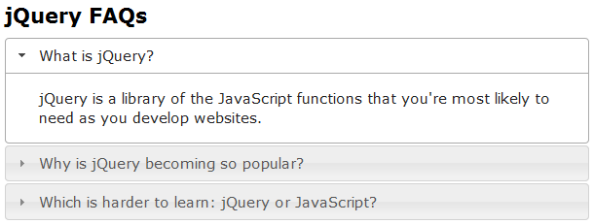
Example
An accordion within a web page

Slide 43
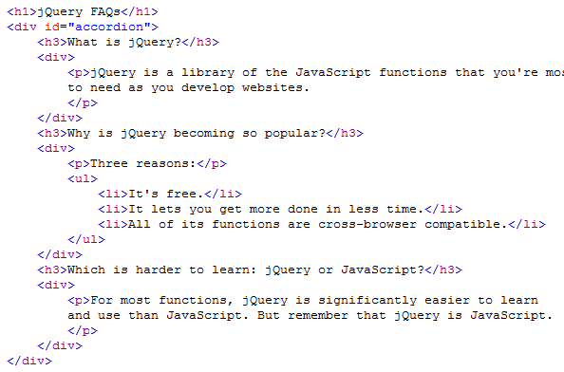
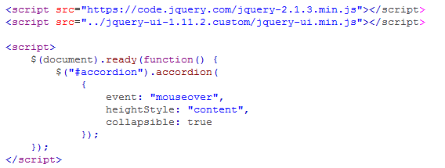
Code for accordion

Slide 44
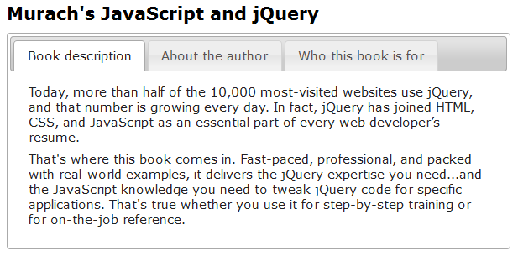
jQuery UI for Tabs widget

Slide 45
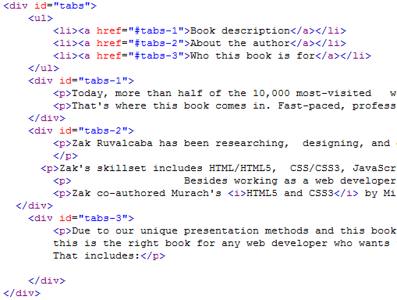
Code for Tabs widget

Slide 46
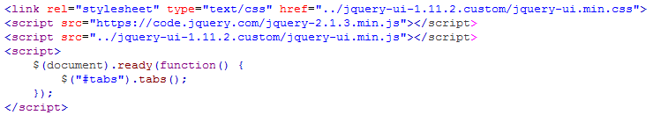
Code for Tabs widget

Slide 47
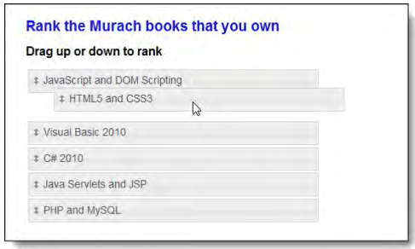
jQuery UI for sortable lists
Use jQuery UI to create a sortable list. A list is displayed when the web page is loaded. The user can drag the items in the list to new locations.
A sortable list as one of the items is dragged upward

Slide 48
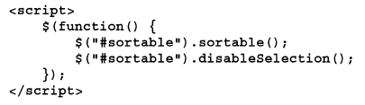
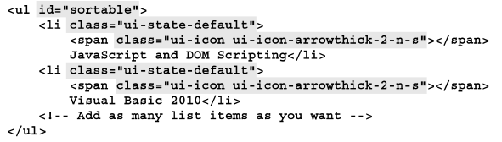
jQuery UI for sortable lists
The script element for the sortable list
The HTML for the sortable list

Slide 49
Introduction to jQuery plugins

Slide 50
Introduction to jQuery plugins
A jQuery plugin is just a jQuery application that does one web task or a set of related web tasks.
A plugin makes use of the jQuery library and most plugins can be used limited knowledge of JavaScript and jQuery.

Slide 51
Three the most popular plugins
Lightbox plugin for images
http://www.jqueryscript.net/lightbox/
bxSliders plugin for carousels
http://bxslider.com/
Cycle 2 plugin for slide shows
http://jquery.malsup.com/cycle2/

Slide 52
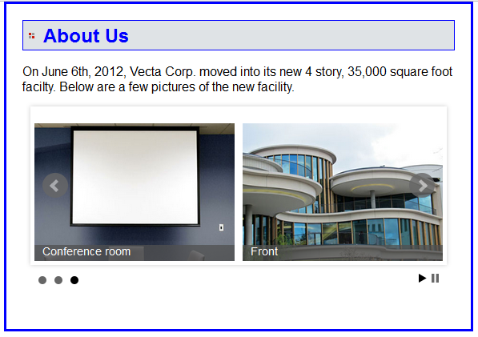
bxSliders plugin for carousels

Slide 53
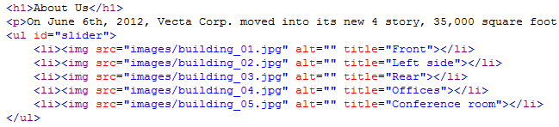
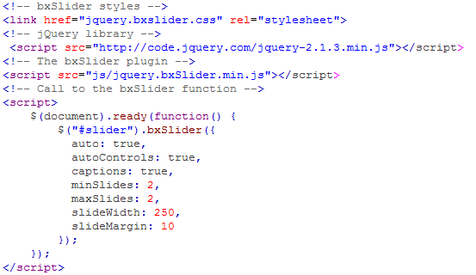
bxSliders plugin for carousels code

Slide 54
Summary
JavaScript is a scripting language that is run by the JavaScript engine of a browser.
The DOM (Document Object Model) is a hierarchical collection of nodes in the web browser’s memory that represents the current web page.
DOM script is the process of changing the DOM using JavaScript.
Notes:
Tóm tắt lại nội dung đã học

Slide 55
Summary
jQuery is a free, open-source, JavaScript library that provides dozens of functions for common web features. JavaScript library that makes JavaScript programming easier.
It provides widgets, interaction, effects, and themes that can be use to build features like carousels and slide shows.

Slide 56
Discussion
Notes:
Trả lời câu hỏi WHY?

